Slide 1
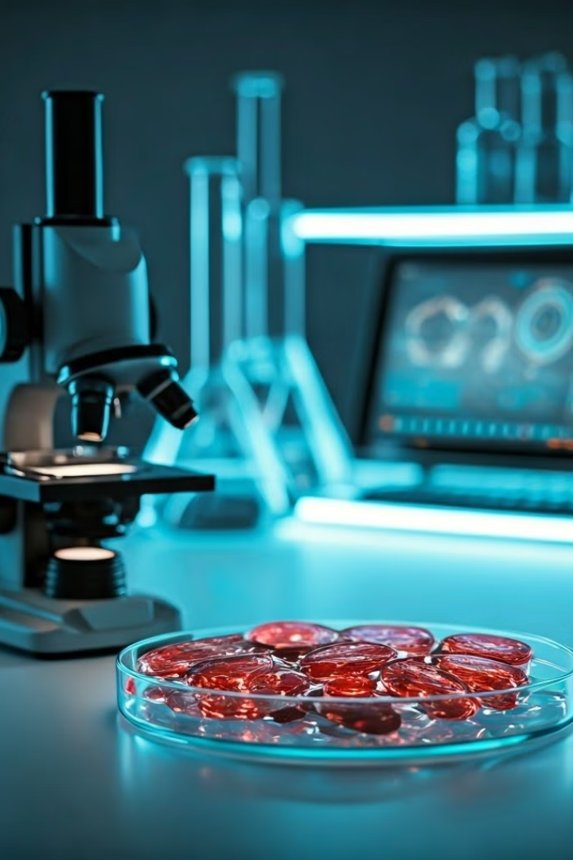

Introduction to BioComputers
BioComputers are a new type of computing system that uses biological elements like DNA, proteins, or living cells to process information. This is a departure from traditional electronic circuits, utilizing biological processes instead.
by איתן קליין

Slide 2
Table of Contents
Why BioComputers
Applications
Future Challenges
Areas of BioComputer
Advancements
Review

Slide 3
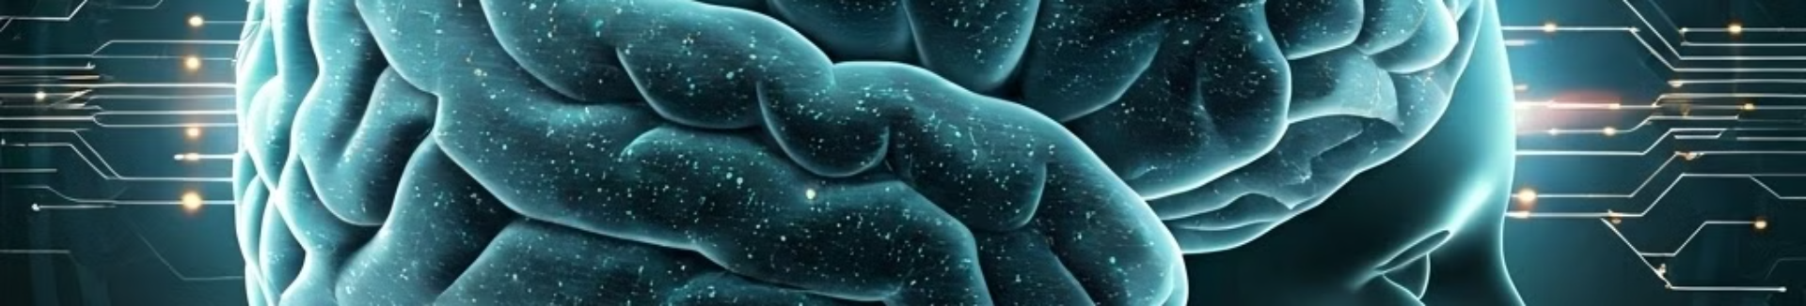
Why BioComputers?
1
Unprecedented Capabilities
2
Molecular Precision
BioComputers have the potential to tackle problems beyond the reach of traditional computers, especially in fields like medicine and diagnostics.
BioComputers can operate at the molecular level, enabling highly precise tasks like targeted drug delivery or disease detection with unmatched accuracy.
3
Energy Efficiency
4
Adaptability and Self-Repair
BioComputers could be significantly more energy-efficient than traditional computers, reducing environmental impact and potentially revolutionizing the way we power computing devices.
BioComputers can adapt to changing environments and potentially self-repair, offering resilience and adaptability that traditional computers lack.

Slide 4
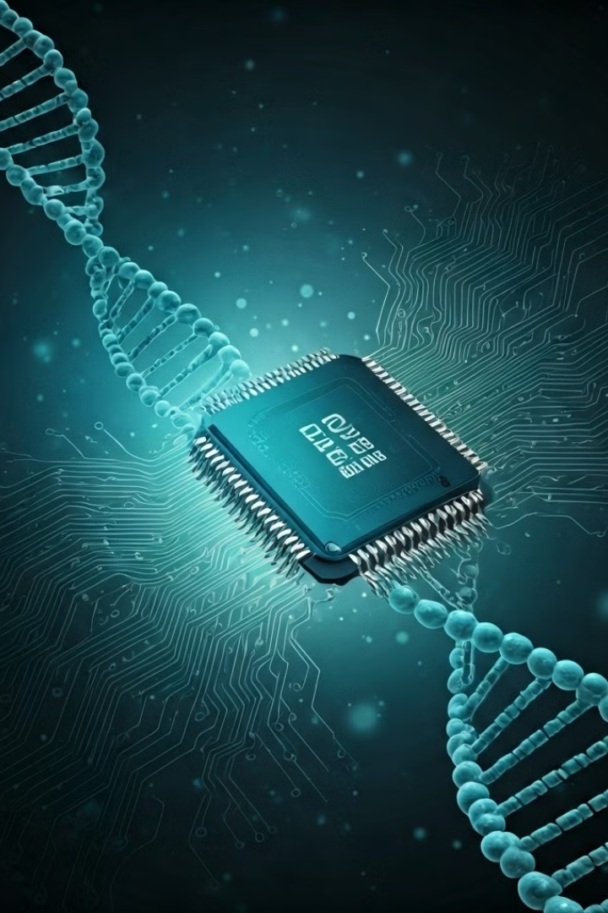
Key Areas of BioComputer Research
DNA Computing
Protein Engineering
Utilizing DNA molecules to store and process information, leveraging the natural properties of DNA for complex computations.
Designing and engineering proteins with specific functionalities to perform computational tasks, creating biological circuits that process information.
Cellular Computing
Harnessing the capabilities of living cells to process information, using cells as computational units for complex tasks like disease detection.

Slide 5
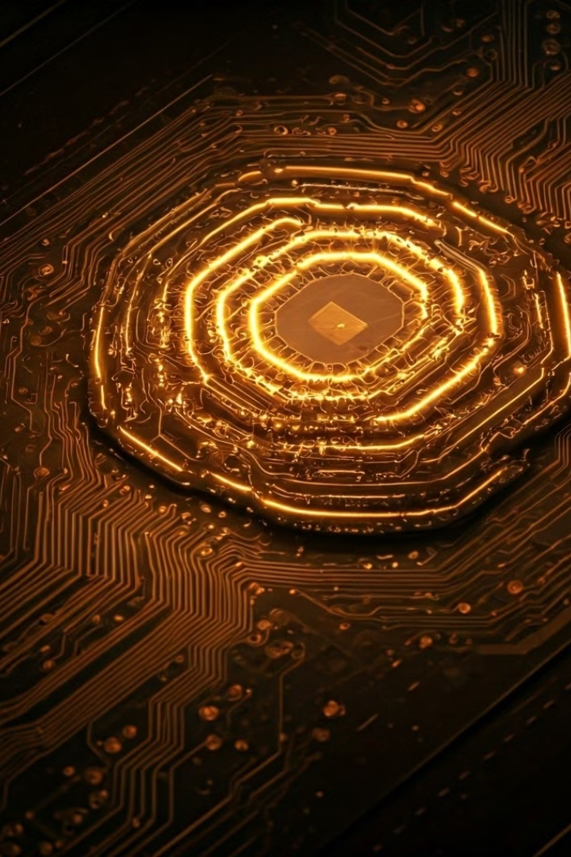
Examples of BioComputer Applications
Disease Diagnosis
Drug Discovery
Environmental Monitoring
BioComputers can be programmed to identify specific disease biomarkers, leading to faster and more accurate diagnoses than traditional methods.
BioComputers can analyze vast libraries of compounds to identify promising drug candidates, accelerating the process of drug discovery.
BioComputers can be used to detect environmental pollutants, monitor ecosystem health, and track changes in environmental conditions.
Cancer Detection
Targeted Therapy Development
Infectious Disease Diagnosis
Personalized Medicine
Water Quality Assessment
Pollution Detection

Slide 6
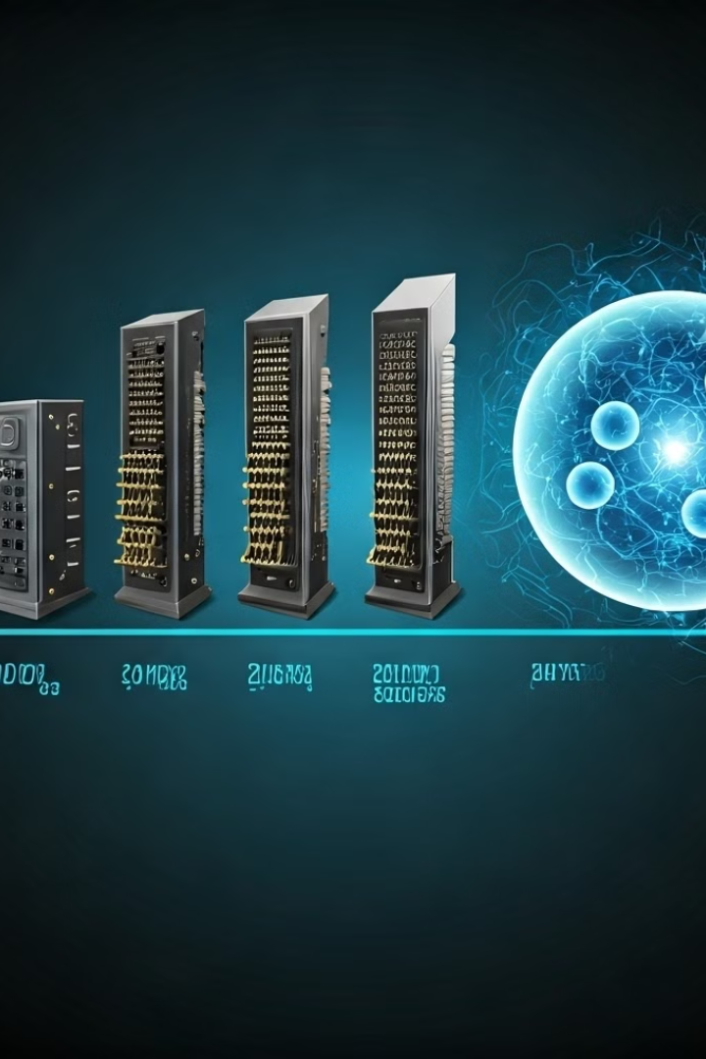
BioComputer Advancements: Before and After
1
Early Research
Initial research focused on basic concepts and proof-of-concept demonstrations. Early BioComputers were limited in their computational power and application.
2
Breakthroughs
Significant breakthroughs have occurred in recent years, leading to the development of more sophisticated BioComputers and expanding their potential applications.
3
Current Research
Current research focuses on refining existing technologies, developing new applications, and addressing the challenges of scalability and integration.

Slide 7




Future Challenges of BioComputer Development
Speed and Efficiency
Cost Reduction
Integration and Compatibility
Improving the speed and efficiency of BioComputers to match or exceed the performance of traditional computers for complex tasks.
Making BioComputers more affordable and accessible for widespread adoption, reducing the manufacturing cost and complexity.
Ensuring compatibility between BioComputers and existing electronic systems, facilitating seamless integration and data exchange.

Slide 8
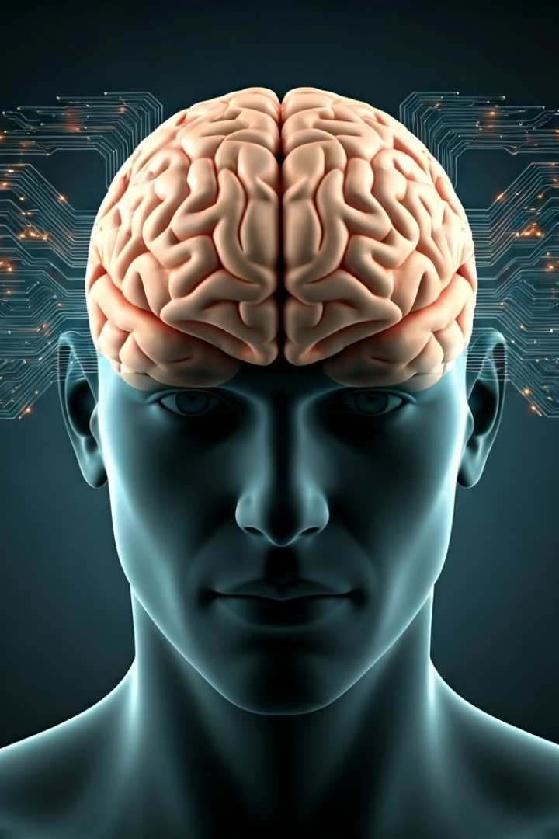



Review of Key Points
Unprecedented Capabilities
BioComputers can solve problems beyond the reach of traditional computers, particularly in medicine and diagnostics.
Molecular Precision
BioComputers operate at the molecular level, enabling highly precise tasks like targeted drug delivery.
Potential Applications
BioComputers have wide-ranging applications in disease diagnosis, drug discovery, and environmental monitoring.

Slide 9

Conclusion
Biological computers represent a breakthrough change in the world of computing, harnessing the enormous power and wisdom of the human body to create extraordinary innovations. By combining biological processes with computational capabilities, we can open up new possibilities that were previously unimaginable, paving the way for advances in medicine, diagnostics and beyond.

Slide 10
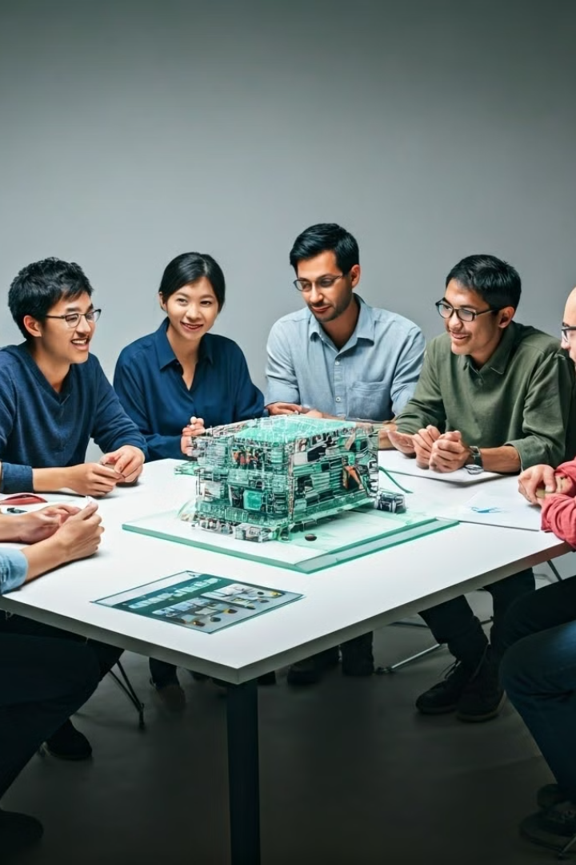
Questions?

